Slide 1
Leadership in Business and Society
BUSN 3052
Communication, coaching and managing conflicts
Lecture 5
Material largely drawn from: Lussier, RN & Achua, CF 2016 Leadership: theory, application and skill development, 6th edition, Cengage Learning, Boston.

Slide 2
Learning outcomes
Understand the steps in the oral message-sending and receiving processes.
Identify the common approaches to getting feedback and their limitations.
Describe the difference between criticism and coaching feedback.
Discuss the relationship between the performance formula and the coaching model.
Define the five conflict management styles.

Slide 3
Communication
Communication is the process of conveying information and meaning.
    True communication happens only when all parties understand the message (information) from the same perspective (meaning).
Communication and leadership.
    Leaders use communication to influence others.
    Formal authority affects communication.
    Managers use communication to monitor and reinforce performance standards.
    There is a positive relationship between communication competency and leadership performance.

Slide 4
Important parts in communication
Sending messages
Receiving messages

Slide 5
Sending messages and giving instructions
Managers give instructions which is sending a message.
      How well you give instructions directly affects performance.
Send messages orally, in writing and nonverbally.
Select the appropriate method for the audience and situation.
Before sending a message, plan it.
    What is the goal of the message?
    Who should receive the message?
    How will you send the message?
    When and where will the message be transmitted?

Slide 6
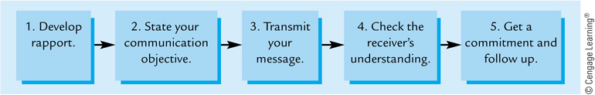
The oral message-sending process
Small talk.
Receiver should know desired end result.
Give instructions.
Ask direct questions and/or paraphrase.
Important step.

Slide 7
Written communication
Lack of organisation is a major problem.
  Set an objective, keeping audience in mind.
  Make an outline and transfer to written form.
Write to communicate, not to impress.
  Keep the message short and simple 1-5-15.
  Use active voice rather than passive voice.
Edit your work and rewrite if needed.
  Have others edit important work.

Slide 8
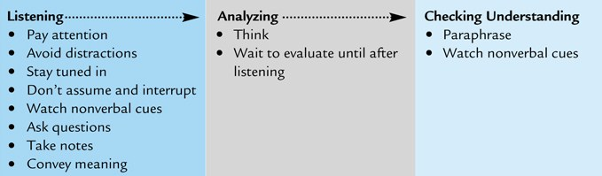
Receiving messages
Includes listening and responding to messages.
Listening is the process of giving a speaker your undivided attention.
Analysing is the process of thinking about, decoding and evaluating the message.
Checking understanding is the process of giving feedback.

Slide 9
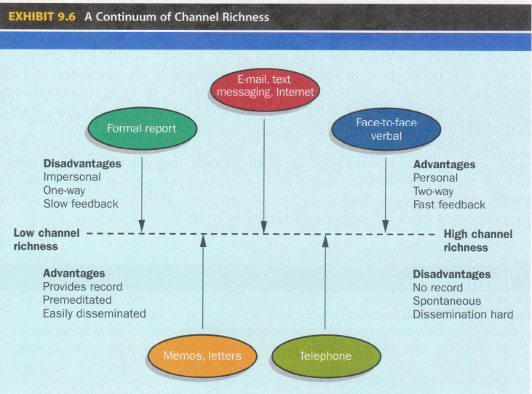
Channel richness
The amount of information that can be transmitted during a communication episode
Source: Daft (2018, p. 277)
Daft RL 2018, The leadership experience, 7th edn, Cengage Learning, Boston, MA.

Slide 10
Feedback
Feedback is the process of verifying messages and determining if objectives are being met.
Role of feedback in verifying messages:
  Paraphrasing is the process of having the receiver restate the message in her/her words.
Role of feedback in meeting objectives:
  Focuses on the leader’s assessment of a follower’s job performance on assigned tasks and responsibilities.
  Ongoing feedback increases motivation.

Slide 11
The need to be open to feedback
To improve your performance, you have to be open to feedback also called criticism.
  People do not enjoy being criticised.
When receiving criticism, view it as an opportunity to improve.
    Stay calm,
    Don’t get defensive, and
    Don’t blame others.

Slide 12
Common approaches to getting feedback and why they don’t work
Assuming
Send the message and assume mutual understanding without getting feedback.
“Do you have any questions?”
Give entire message and ask for questions, feedback does not usually follow – people do not ask questions.
Another common error is assuming no questions means there is mutual understanding.
Getting feedback ensures mutual understanding.

Slide 13
How to get feedback on messages
Be open to feedback.
  If questions upset you, you will get no questions.
Be aware of nonverbal communication.
  Make sure yours encourages feedback.
Ask questions.
  Ask direct questions on specific information.
Use paraphrasing.
  How we ask for paraphrasing affects attitude.
    ‘Now tell me what you are going to do, so we will be sure that we are in agreement’
    ‘Would you tell me what you are going to do, so that I can be sure that I explained myself clearly?’.

Slide 14
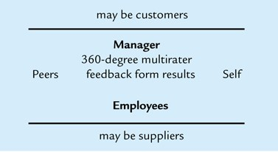
360-Degree multi-rater feedback
Based on receiving performance evaluation from multiple sources.

Slide 15

Coaching
Coaching is the process of giving motivational feedback to maintain and improve performance.
  Based on feedback and communications.
  Boosts performance.
Coaching is not just for athletes, managers should look for steady performance and continual improvement.

Slide 16
Coaching guidelines
Develop a supportive working relationship
Give praise and recognition
Avoid blame and embarrassment
Focus on the behaviour, not the person
Have employees assess their own performance
  Criticism
    ‘Are you going to meet the deadline for the report?’
  Self-evaluation
    ‘How are you progressing on the report that’s due this Thursday? Is there something I can do to help?’
Give specific and descriptive feedback
  factual feedback are specific and positive
    ‘How would you assess the number of errors you have been making this week?’
  Inferential feedback tends to be more negative criticism
    ‘Are you going to meet the deadline for the report?’

Slide 17
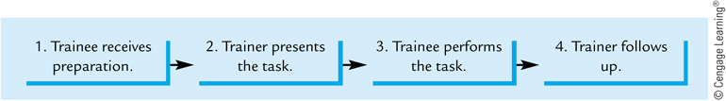
Coaching guidelines …
Give coaching feedback
  ‘Would you like me to show you how to put attendance records faster on the system?’
Provide modelling and training
  A good leader leads by example
  The Job Instructional Training Method (JIT) is widely used
Put the trainee at ease, create interest in the job and encourage questions.
For complex tasks with multiple steps, give employee a copy of written steps.
Correct any errors, be patient and helpful, continue until trainee is proficient.
Correct any errors or faulty work procedures before they become a habit.
Make feedback timely, but flexible and don’t criticise

Slide 18
Criticism vs. Coaching feedback
Criticism is rarely effective, employees get defensive and develop a negative attitude.
Coaching feedback is based on a good, supportive relationship; it is specific and descriptive; and it is not judgmental criticism.
Criticism makes employees feel like losers, coaching feedback makes them feel like winners.

Slide 19
Performance formula
Performance = Ability * Motivation * Resources
  When ability is the reason:
      The corrective action is training (JIT).
  When motivation is lacking:
      Motivational techniques, such as praise, may help.
  When resources are the problem:
      Get the resources (e.g., tools, materials, equipment, etc.).

Slide 20
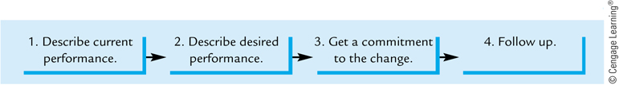
Coaching model
    In detail, with examples, describe behaviour to change.
Tell employee desired performance, in detail.
    Unless the reason was ability and employee seems willing to change.
To ensure employee is behaving as desired.

Slide 21
Mentoring
Mentoring is a form of coaching in which a more-experienced manager helps a less-experienced protégé.
  Primary responsibility is to coach by providing good, sound career advice and help develop leadership skills.
  Seek out a good mentor – formal or informal.

Slide 22
Managing conflict
A conflict exists whenever people are in disagreement and opposition.
All human relations rely on the:
  psychological contract – set of unwritten implicit expectations of each party in a relationship.
      ‘I give my time, effort, loyalty : I receive a secure job, managerial support, career opportunities, etc.’
      Contributions: effort, loyalty, knowledge, skills, creativity, time
      Inducements: pay, security, benefits, status, career, praise
    Often unaware of our expectations until they are unmet.
Conflict arises when the contract is broken.

Slide 23
Broken Contract
We fail to communicate our expectations or ask about expectations of other party.
We further assume other party has same expectations as us.
Conflict can be
Functional conflict – disagreement and opposition supports meeting objectives.
Dysfunctional conflict – prevents the objectives from being met.

Slide 24
Conflict management styles
Based on the concern for other’s needs and concern for one’s own needs.
Three types of behaviours
  Passive
    When the concern for one’s own needs is low and the concern for other’s needs is high
  Aggressive
    When the concern for one’s own needs is high and the concern for other’s needs is low
  Assertive
    A moderate of high concern for one’s own needs and others’ needs

Slide 25
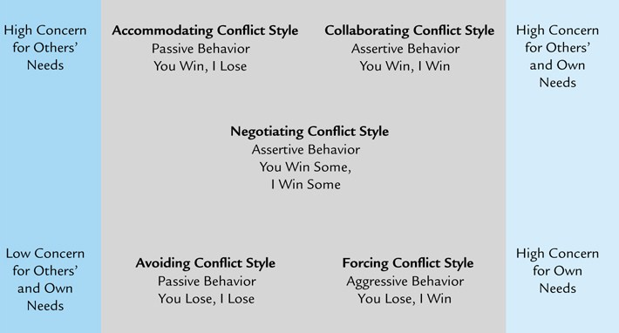
Conflict management styles

Slide 26
Avoiding conflict style
The avoiding conflict style user passively ignores the conflict rather than resolve it.
Appropriate use:
    When conflict is trivial,
    When your stake is not high,
    When confrontation would damage relationship, or
    When time is short or emotions are high.
Advantage
Disadvantage
Maintains relationships.
No resolution.

Slide 27
Accommodating conflict style
The accommodating conflict style user passively gives in to the other party.
Appropriate use:
    The person enjoys following,
    Maintaining the relationship is priority,
    Changes are not important to accommodator, or
    Time is limited.
Advantage
Disadvantage
Maintains relationships.
May be counterproductive.

Slide 28
Forcing conflict style
The forcing conflict style user uses aggressive behavior to get their way.
Appropriate use:
    Unpopular action must be take on important issues,
    Commitment is not crucial to implementation,
    Maintaining relationships is not critical, or
    Conflict resolution is urgent.
Advantage
Disadvantage
Better decisions if forcer is correct.
Overuse leads to hostility.

Slide 29
Negotiating conflict style
The negotiating conflict style user attempts assertive, give-and-take concessions.
      Also called compromising style.
Appropriate use:
    When issues are complex and critical,
    Parties have equal power and differing solutions, or
    A solution will only be temporary or if time is short.
Advantage
Disadvantage
Conflict is resolved quickly.
Can lead to subpar decisions.

Slide 30
Collaborating conflict style
The collaborating conflict style user seeks joint resolution with best solution for all.
      Also called problem-solving style.
Appropriate use:
    When compromise would result in sub-optimisation,
    When group goal comes first and members collaborate,
    Maintaining relationships is important, or
    Time is available or when it is a peer conflict.
Advantage
Disadvantage
Can lead to the best solution
Time consuming

Slide 31
Summary
Leaders use communication to influence others.
Communication is the process of conveying information and meaning.
Leaders should select the best channel to transmit their messages.
Providing feedback is important to verify messages and determine if objectives are being met.
Coaching is the process of giving motivational feedback
Leaders are required to effectively manage conflicts.

